Slide 1

CS 6417 – Software Security
Final Project
Presented By-
Name: Ashique Arman
Student ID: 3739860

Slide 2
Resources
https://attack.mitre.org/tactics/TA0006/
https://book.hacktricks.xyz/pentesting-web/registration-vulnerabilities
CS 6411 Slides (Chapter: Risk Management. Page: 23-25)

Slide 3


Slide 4
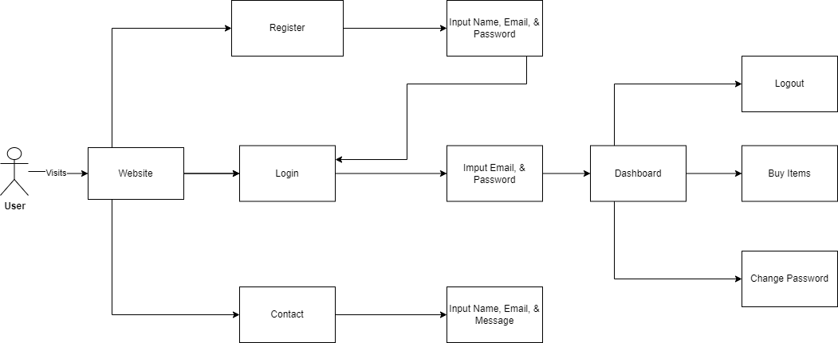
Project Overview

Slide 5
Attack Surface
Registration Page
Duplicate Registrations: Changing email addresses that are already there by adding special characters like: "+1@" or leaving empty spaces.
Login Page
Brute Force Attack: Attackers might use different tools and techniques to guess passwords.
Credential Stuffing: Attackers could try using usernames and passwords stolen from leaked databases to get into the website.
Session Hijacking: If the website doesn't properly secure session tokens well, attackers could take them and pretend to be real users.
Contact Page
SQL Injection: If the info typed in (like Name, Email, Message) isn't validated or sanitized properly, hackers could sneak harmful stuff into the website's database.
Cross-Site Scripting (XSS): This lets attackers add malicious code to the page, which can mess up other people's browsers.

Slide 6
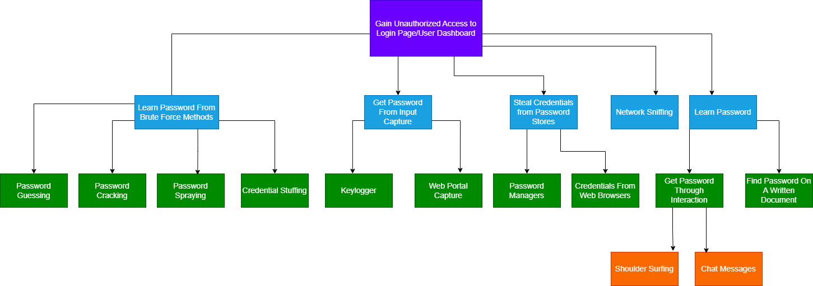
Attack Tree
Level 1
Level 2
Level 3
Level 4
Attack Tree for the Login Page

Slide 7
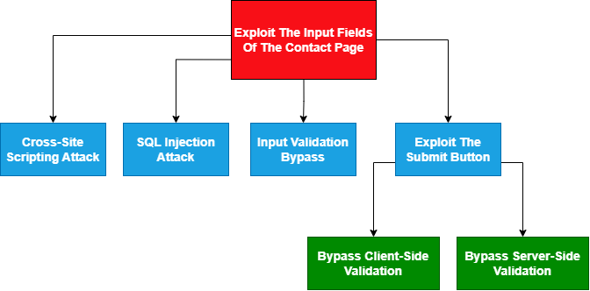
Attack Tree
Level 1
Level 2
Level 3
Attack Tree for the Contact Page

Slide 8
Project Link
GitHub: https://github.com/AshiqueArman/marketplace

Slide 9
Thank You!

